Slide 1
Network Administration and Support
Chapter 10 – I won a math debate

Slide 2
Learning Objectives
Manage networked accounts
Enhance network performance
Create a network security plan
Protect servers from data loss

Slide 3
Network Administration
Network administration involves many areas:
Ensure network performs to specifications
Verify users can easily access resource they are authorized to use
Monitor network traffic
Be responsible for security issues
Critical area is managing user accounts and groups
Set permissions and grant rights

Slide 4
Managing Networked Accounts
Users should be able to access resources they are allowed to access
Prevent users from accessing resources they do not have permission to access
Many ways to assign permissions
Principles are same, but details differ
NOSs have user management utilities

Slide 5
Creating User Accounts
Windows has two predefined accounts:
Administrator – used to manage network; should create strong password and guard account; good idea to rename it; account cannot be disabled
Guest – for users without personal accounts

Slide 6
Creating User Accounts
Must make decisions before creating other user accounts:
User Names –how many letters
Passwords – when to change, what restrictions on reusing same password, how to handle account lockouts
Logon Hours – what restrictions
Auditing – what to track

Slide 7
Passwords
Users should change passwords for security
If require changes too frequently, users may forget password
Can set restrictions about when old password may be reused
Combine upper and lower-case letters since most passwords are case sensitive
Include numbers or high-level characters to prevent dictionary attacks

Slide 8
Passwords
Limit number of times user may enter wrong password before account is locked
Longer passwords are better
Different NOS have different maximum character limitations for passwords:
Windows 2000 limit is 128 characters
Windows NT limit is 14 characters
Linux limit is 256 characters

Slide 9
Logon Hours
Can restrict logon hours by time, day, or both
Prevents intruder break-in after working hours
Determine what happens when user is logged in and authorized time expires
Can disconnect user or just prevent connection to new resources

Slide 10
Auditing
Records certain actions for security and troubleshooting
Can log only failed access attempts or all accesses
Should use auditing sparingly
Can adversely affect availability of system resources

Slide 11
Setting User Rights
Simplify network administration by assigning rights to groups
Two general kinds of groups:
Local groups – use only single machine
Table 10-1 shows rights assigned to default local groups for Windows 2000
Global groups – use within or across domain boundaries
Universal group is new type in Windows 2000
Users may belong to more than one group

Slide 12
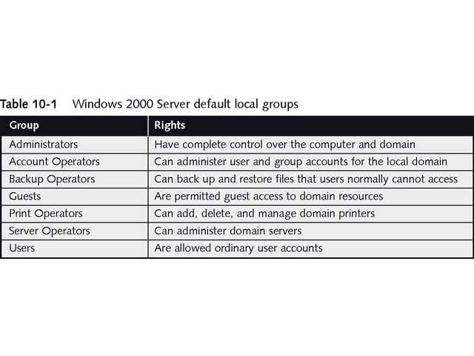
Windows 2000 Server Default Local Groups

Slide 13
Setting User Rights
Some group memberships are automatic
See Table 10-2
All users belong to Everyone group
May want to change rights
In Windows NT, changes written to Registry in files Security and Security Accounts Manager (SAM)
In Windows 2000, changes written to Active Directory database

Slide 14
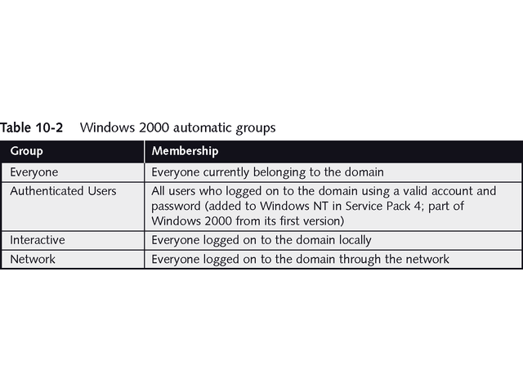
Windows 2000 Automatic Groups

Slide 15
Managing Group Accounts
Can add and delete rights for groups
Can nest groups within other groups
Windows 2000 must use native mode to do so
Local groups can include global groups, but not vice-versa
Allows cross-domain communication
Trust relationship is when members of one domain access resources in another domain

Slide 16
Trust Relationships
Manage cross-domain communications
In Windows NT, use Trust Relationships dialog box, as seen in Figure 10-1
For Windows 2000, trust relationships automatically extend to interrelated domains
Three types of trusts:
One-way trust
Two-way trust
Universal trust

Slide 17
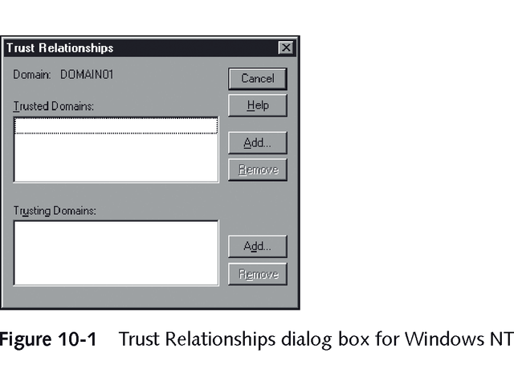
Trust Relationships Dialog Box for Windows NT

Slide 18
Disabling and Deleting User Accounts
Windows 2000 has two options to make user account inactive:
Disable it – temporarily turning account off; retains all assigned rights and may be restored
Delete it – removes account completely
Cannot disable or delete Administrator account

Slide 19
Renaming and Copying User Accounts
Two options when new user replaces existing user:
Rename old account – must change password
In Windows 2000/XP Professional, use Users and Passwords utility, shown in Figure 10-2
In Windows 2000 Server, use Active Directory Users and Computers management console, shown in Figure 10-3
Copy old account into new one with different username; then disable old account

Slide 20
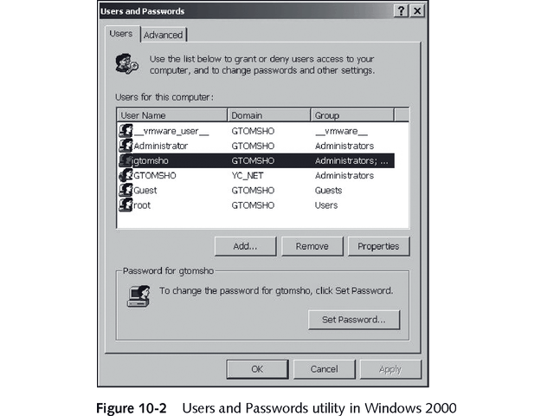
Users and Passwords Utility

Slide 21
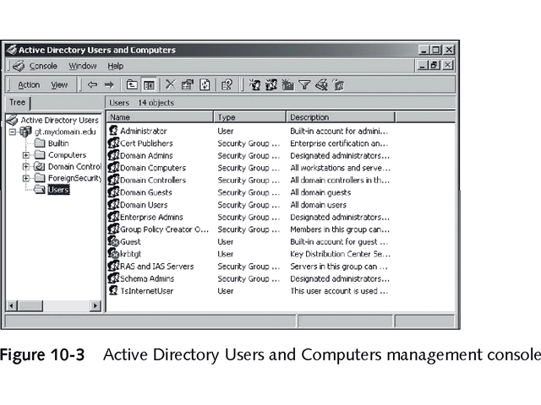
Active Directory Users and Computer Management Console

Slide 22
Managing Network Performance
Monitor these parameters:
Data read from and written to server each second
Queued commands
Number of collisions per second on Ethernet network
Security errors
Connections currently maintained to other servers (server sessions)
Network performance

Slide 23
Network Performance
Three tools monitor system performance for Windows NT or Windows 2000 Server:
Event Viewer
Performance Monitor
Network Monitor
Numerous open source and shareware utilities for Linux servers

Slide 24
Event Viewer
Event Viewer, shown in Figure 10-4, creates three log files:
System Log – records information about operating system services and hardware
Security Log – records security events based on audit filters or policy settings
Application Log – maintains information about applications

Slide 25
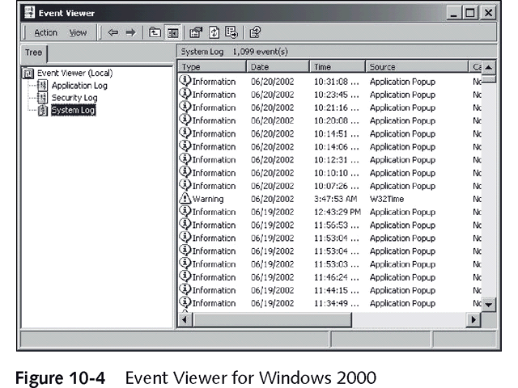
Event Viewer in Windows 2000

Slide 26
Event Viewer
With Active Directory, Event Viewer creates three more logs:
Directory Service
DNS Server
File Replication Service

Slide 27
Performance Monitor
Records individual events to show trends
Keeps track of certain counters for system objects
Object is portion of software that works with other portions to provide services
Counter is part of object that tracks particular aspect of its behavior
Figure 10-5 shows % Processor Time and % Interrupt Time per second

Slide 28
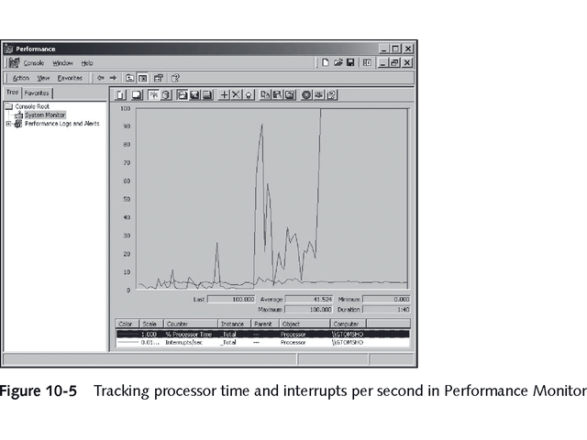
Tracking Processor Time and Interrupts with Performance Monitor

Slide 29
Performance Monitor
Monitor these system objects to identify bottlenecks:
Logical or physical disk on server
Network interface
Protocol counters, such as IP packets per second
Redirector
Server
Server work queues
Monitor when everything works well to establish baseline for comparison

Slide 30
Network Monitor
Must install separately from CD-ROM with Windows
Becomes part of Administrative Tools menu
Works as software-based protocol analyzer
Monitors network traffic and creates reports
See Figure 10-6
Apply filters to monitor only data you want
Gives reading on overall network performance

Slide 31
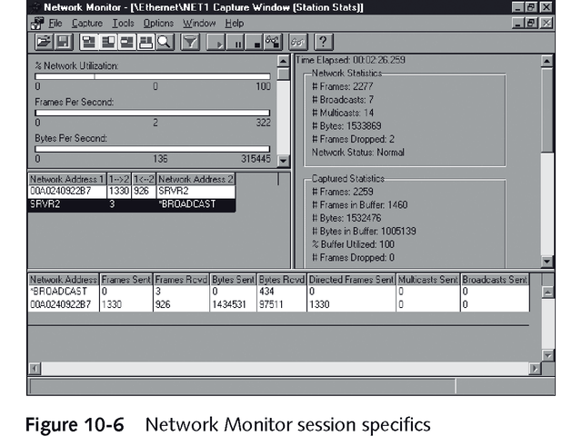
Network Monitor Session Specifics

Slide 32
Total System Management
Monitor server hard drive and memory and CPU usage
Hard Drive Performance - Use Performance Monitor to see remaining disk space, how fast requests are serviced, and how often disk is busy
Memory Use – Monitor paging file, including soft and hard page faults
CPU Utilization – Monitor %Process Time counter to get average utilization over past second

Slide 33
Network Statistics
Check network interface and protocol stack objects using Performance Monitor
Monitor network utilization with Network Monitor or Bytes Total/Sec in Performance Monitor to get measure of network’s health
Acceptable utilization rates vary
With token ring network, 80% utilization is acceptable
With Ethernet network, utilization rate should stay below 56-60% range

Slide 34
Maintaining a Network History
Keep long-term records of network performance and events
Use them to determine trends and identify new problem
Do not keep more data than you can analyze

Slide 35
Managing Network Data Security
Two elements of data security
Ensure that data is safe from intruders
Ensure that damaged data can be replaced
Plan for network security
Identify threats
Consider cost-effectiveness of security
Communicate with other managers in office to make sure security system meets needs

Slide 36
Security Models
Two security viewpoints:
Physical security – based on hardware
Data security – based on software
Two security models for software security
Share-oriented model – attach security information to object; apply to everyone who may access object
User-oriented model – focuses on rights and permissions of each user

Slide 37
Implementing Security
Two-stage process
Set up security system and make it as foolproof as possible; includes setting up passwords
Train users about system, how to use it, and consequences of failure to comply

Slide 38
New Security Features in Windows 2000
Many significant changes in Windows 2000 involve security, including:
Kerberos v5 for login authentication
Public Key Infrastructure (PKI) for exchange of “digital signatures” and “digital certificates”
Enhanced security policy mechanisms consolidated within Group Policy mechanism managed in Active Directory
Improved IP security mechanisms and protocols
Unix and Linux previously included most of these features

Slide 39
Maintaining Security
Make sure plan accomplishes goals and works as intended.
Modify plan to cover omissions

Slide 40
Security Against Viruses
Computer virus is big security threat
Implement virus protection at these locations:
Workstation – protects a single computer by scanning files from server or e-mail messages
Server – scans data read from or written to server; prevents virus from server spreading throughout network
Internet gateway – scans all Web browser, FTP, and e-mail traffic; stops viruses before they enter network

Slide 41
Using Firewalls to Prevent Internet Attacks
Advantages of using firewalls
Protect against outside attempts to access unauthorized resources
Protect against malicious network packets that disable network and its resources
Restrict access to Internet resources by corporate users
Corporate firewalls may be expensive and complicated to configure
Personal firewall for home users guards against Internet attacks

Slide 42
Avoiding Data Loss
Hard drive failure more likely than risk of break-in
Use three-tiered scheme to protect data
Reduce chance of data loss
Make quick recovery from data loss easy
Completely rebuild lost or corrupted data

Slide 43
Tape Backup
Most popular backup method
Offers speed, capacity, and cost-effectiveness
Five types of backups
Full
Incremental
Differential
Copy
Daily

Slide 44
Tape Backup
Good model is full weekly backup and daily differential backup
Allows restoration from only two types
Be sure to post schedule and assign one person to perform backups
Test to verify that backups can be restored
Store tapes in cool, dry, dark place
Rotate tapes

Slide 45
Repairing or Recovering Windows Systems
Network operating systems include repair utilities
Windows NT uses Emergency Repair (ERD) disk
Windows 2000 Recovery Console is more powerful, supporting 26 commands
First step in restoration is to boot from CD-ROM or from set of boot floppies

Slide 46
Uninterruptible Power Supply
Has built-in battery to allow orderly shutdown and includes other capabilities:
Power conditioning cleans power, removing noise
Surge protection protects computer from sags and spikes
Two categories of UPS
Stand-by – must switch from wall to battery power
Online – continually supplies power through battery; no switching

Slide 47
Fault-Tolerant Systems
Fault-tolerant disk configurations, implemented through hardware or software
Two popular types:
Disk mirroring (or duplexing)
Disk striping with parity
Based on Redundant Array of Inexpensive Disks (RAID)
Table 10-3 describes Raid levels

Slide 48
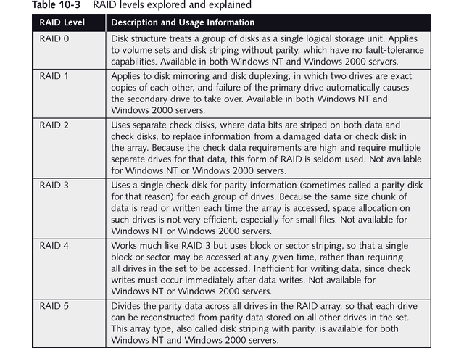
RAID Levels

Slide 49
RAID 1: Disk Mirroring
Mirroring requires writing data to two disks, working in tandem
Duplexing uses two disks and two controllers
Main disadvantage is using twice as much disk space as data

Slide 50
RAID 5: Disk Striping with Parity
More space-efficient
Requires at least three disks
Windows NT and Windows 2000 Server support arrays up to 32 disks, treated as single logical drive
Figure 10-7 illustrates stripe set with parity
Can recovery only from single failed disk
Disadvantage is extra memory required for parity calculation

Slide 51
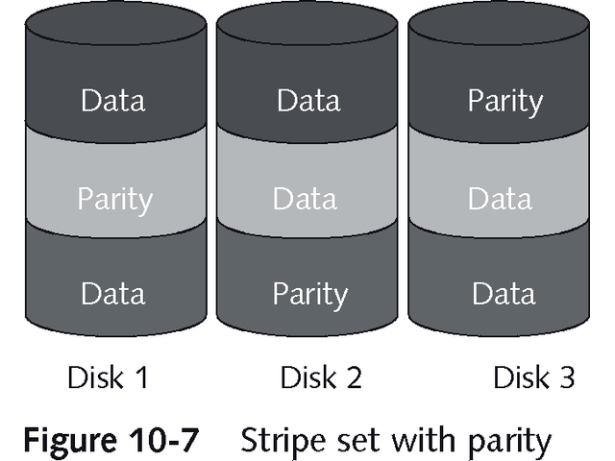
Stripe Set with Parity

Slide 52
Intellimirror
Client-server application introduced with Windows 2000 as part of Microsoft Zero Administration initiative for Windows (ZAW)
Creates “smart back-up copy’ of system on server
Works from domain policy settings and user account permissions
Recreates user’s desktop on whatever machine user logs onto
Can deploy, recover, restore, or replace user data, software, and personal settings

Slide 53
Chapter Summary
Network maintenance is continuing process, not just installing hardware and software
Network administrator must be vigilant about network management
Main task of network management is to ensure that users can access what they are allowed to access but cannot access resources they don’t have permission to access

Slide 54
Chapter Summary
Windows NT and Windows 2000 use User Manager for Domains and Active Directory Users and Computers utilities, respectively, to manage users and groups
Groups may be either local or global
Users are automatically added to some groups, such as Everyone, at log on
Rights can be granted to individual user accounts or to groups to control access to various objects and resources on network

Slide 55
Chapter Summary
Passwords should be changed regularly and the same password should not be used repeatedly
To make password less immune to dictionary attacks, pick two words plus a punctuation mark, combine upper- and lowercase letters, or combine letters with two or more numbers
Cross-domain communications are managed through trust relationship in Windows NT and Windows 2000

Slide 56
Chapter Summary
Trust relationship lets members from one domain access resources of another domain
In Windows NT, you can establish one-way or two-way “trust” between domains
Automatic trust relationships are all two-way trusts in Windows 2000
Monitor performance of a Windows NT or Windows 2000 Server network using Event Viewer, Performance Monitor, and Network Monitor

Slide 57
Chapter Summary
Use various tools to audit system, driver, security, and application information
Both physical security, based on hardware, and data security, based on software, are important network security issues
Share-oriented security and user-oriented are two types of software security

Slide 58
Chapter Summary
Important new security features in Windows 2000 include Kerberos v5 authentication, Public Key Infrastructure (PKI), enhanced security policy mechanisms, and improved IP security mechanisms and protocols
Virus protection is critical part of maintaining security on a network
Virus protection can be implemented at workstation, server, or Internet gateway, and preferably at all three locations

